Slide 1
Types of Questionnaire

Slide 2
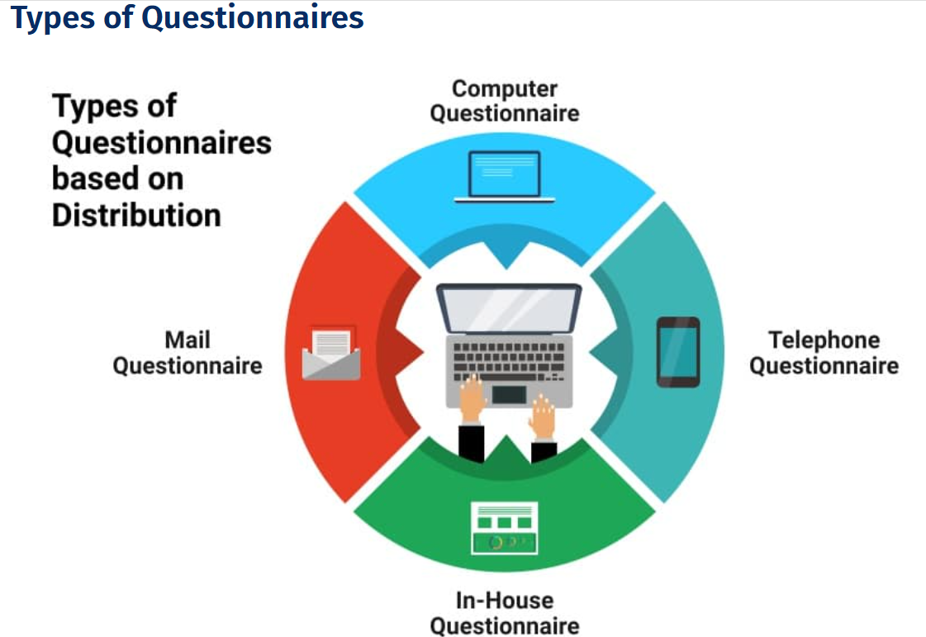

Slide 3
Questionnaires can be administered or distributed in the following forms:
Online Questionnaire: In this type, respondents are sent the questionnaire via email or other online mediums. This method is generally cost-effective and time-efficient. Respondents can also answer at leisure. Without the pressure to respond immediately, responses may be more accurate. The disadvantage, however, is that respondents can easily ignore these questionnaires. Read more about online surveys.
Telephone Questionnaire: A researcher makes a phone call to a respondent to collect responses directly. Responses are quick once you have a respondent on the phone. However, a lot of times, the respondents hesitate to give out much information over the phone. It is also an expensive way of conducting research. You’re usually not able to collect as many responses as other types of questionnaires, so your sample may not represent the broader population.
In-House Questionnaire: This type is used by a researcher who visits the respondent’s home or workplace. The advantage of this method is that the respondent is in a comfortable and natural environment, and in-depth data can be collected. The disadvantage, though, is that it is expensive and slow to conduct.

Slide 4
Mail Questionnaire: These are starting to be obsolete but are still being used in some market research studies. This method involves a researcher sending a physical data collection questionnaire request to a respondent that can be filled in and sent back. The advantage of this method is that respondents can complete this on their own time to answer truthfully and entirely. The disadvantage is that this method is expensive and time-consuming. There is also a high risk of not collecting enough responses to make actionable insights from the data.

